Slide 1
Nasogastric Tube Insertion and Feeding A nasogastric tube is a narrow bore tube passed into the stomach via the nose. It is used for short- or medium-term nutritional support, and also for aspiration of stomach contents
SKHMC-SDCCP

Slide 2
Introduction :
Nasogastric tube feeding is common practice and many tubes are inserted daily without incident. However, there is a small risk that the tube can become misplaced into the lungs during insertion, or move out of the stomach at a later stage .
Auscultation must not be used to check correct nasogastric tube (NGT) placement as studies have shown this method to be inaccurate. NG tubes should be aspirated and the tube position confirmed using pH indicator strips that are CE marked and intended for use on human gastric aspirate.

Slide 4
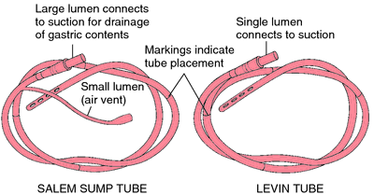
DEFINITION OF NGT INSERTION
Naso-gastric a method of introducing a tube through nose into stomach for therapeutic or diagnostic purpose.
Naso-gastric feeding tube:-
Defined as between a 6 – 8 french gauge. The length of the tube is measured in cms starting at the distal tip (stomach end = “0” cms). The tube is made of silicone or polyurethane which is passed through the nostril via the naso-pharynx into the oesophagus, then stomach.
Nasogastric tubes used for the purpose of feeding must be radio-opaque throughout their length and have externally visible length markings.

Slide 5
PURPOSE OF NGT INSERTION :
To feed with fluids when oral intake is not possible
To dilute and remove consumed position.
To instil ice cold solution to control gastric bleeding.
To prevent stress on operated site by decompressing
To relieve vomiting and distention
To collect gastric juice for diagnostic purposes.

Slide 6
DUTIES AND RESPONSIBILITIES :
Medical Staff:-
The decision to commence artificial nutrition via a naso-gastric tube is a medical decision to be made in conjunction with the patient, the patients’ family and members of the MDT.
Before a decision is made to insert a naso-gastric tube, an assessment is undertaken to identify if nasogastric feeding is appropriate for the patient, and the rationale for any decisions is recorded in the patients’ medical notes.
Radiology Department:
Radiographers:- are responsible for ensuring that the nasogastric tube can be clearly seen on the x-ray to be used to confirm tube position.

Slide 7
…..DUTIES AND RESPONSIBILITIES
Healthcare Professionals (including Registered Nurses)
Healthcare Professionals are responsible for establishing the gastric placement of NGTs prior to their use and to document this using the NG checking chart.
It is the responsibility of the Healthcare Professional to develop and maintain their own level of care.
Clinical Nutrition Nurse Specialists(CNNS):
CNNS team is responsible for providing training and education to PHT staff on the insertion and management of nasogastric feeding tubes.
Clinical Nutrition Nurse Specialists in conjunction with Modern Matrons, Ward Managers, and Practice development Nurses and Clinical Educators are responsible for the management and Implementation of this policy.

Slide 8
EQUIPMENT REQUIRED FOR NGT INSERTION PROCESS:
A tray containing-
Drainage bag or enteral administration set, if needed
Non sterile disposable gloves / PPE
Oral /enteral syringe 20ml or 50ml x 2
pH indicator strips - non bleeding
Lubricant (water soluble)
Safety pin (to attach tube to clothing)
Vomit bowl
Tissue & towel / absorbent sheet
Adhesive tape (Fixomul or similar)

Slide 9
EQUIPMENT REQUIRED FOR NGT INSERTION PROCESS:

Slide 10
EQUIPMENT REQUIRED FOR NGT INSERTION PROCESS:
Penlight / torch
NGT (Consider duration of use & why tube needed e.g. gastric drainage, feeding or medication)
Glass of water (only if the patient is not Nil by mouth / fasting) & straw.
Additional equipment which may be required:
Local anesthetic if prescribed on MR810
Spigot, specimen container and Laboratory request form.

Slide 11
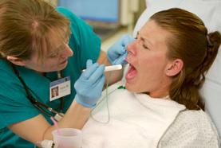
PROCEDURE- NASOGASTIC INSERTION :
Wash hand thoroughly
Measure distance of tube from tip of
patient’s ear lobe to nose to tipoff xiphoid process.
Mark the distance of the tube
Lubricate the tube of about 6 to 8 inches with the lubricant using a rag pieces or a paper square.
Hold the tube coiled in the right hand introduces the tip into the left nostril.
Pass the tube gently but quickly backwards momentary resistance may occur as the tube is passed into the naso-pharynx.

Slide 12
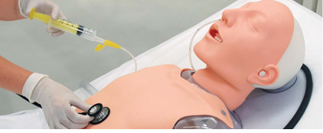
PROCEDURE- NASOGASTIC INSERTION :
When the tube reaches to pharynx the patient may gag. Allow him to rest for a movement.
Have the patient take the sips of water on command advance the tube 3-4 inches each time swallows.
Make sure tube is in stomach.
Once location of NG tube insured close other end of tube with spigot, secure tube on nose using adhesive in ‘T’ or butterfly.

Slide 13
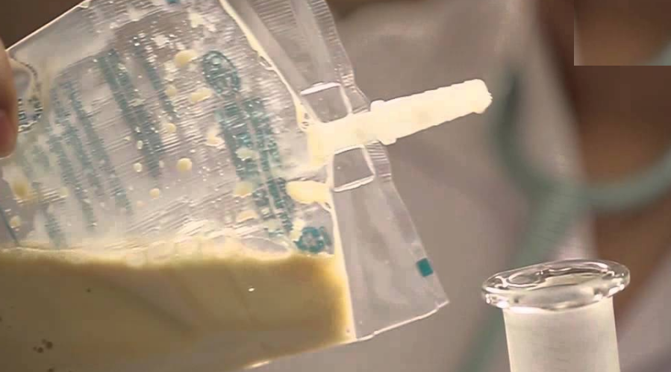
NASOGASTRIC TUBE FEEDING (NGT FEEDING)

Slide 14
Introduction :
Patients in the hospital, as well as home care settings, often require nutritional supplementation with enteral feeding. Enteral feeding can
be administered via nasogastric, nasoduodenal and nasojejunal
means. The focus of this clinical practice guideline is on the nursing
management of nasogastric tube feeding.
Nasogastric tube feeding may be accompanied by complications.
Thus, it is important for the practitioner to be aware of how to prevent
these complications so that nasogastric tube feeding can be
administered successfully and safely.

Slide 15
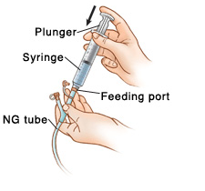
DEFINITION :
Nasogastric tube feeding is defined as the delivery of nutrients from the nasal route into the stomach via a feeding tube.

Slide 16
ALGORITHM FOR MANAGEMENT OF NGT FEEDING :

Slide 17
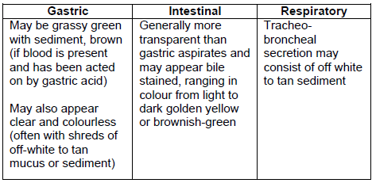
VISUAL CHARACTERISTICS OF FEEDING TUBE ASPIRATES :
Combination of pH and visual characteristics can be helpful in
distinguishing between respiratory and gastrointestinal tube position.
pH less than 5 indicates gastric placement, whereas a pH more than
5 indicates intestinal or respiratory placement.

Slide 18
Frequency in Checking Placement
Mark the intersection where the nasogastric tube enters the nostril, use this marking to check the tube placement:
after initial insertion, before each intermittent feeding, and at Every 8-hourly during continuous feedings.
If patients complain of discomfort, coughing, retching or
Vomiting and show sudden signs of respiratory difficulties.
If the visible part of the tube changes in the length.

Slide 19
Maintaining Tube Patency :
Flush feeding tubes with 30 ml of water before and after intermittent feeding, every 4-hourly during continuous feeding and after checking for gastric residuals. More frequent flushing might be ordered according to patient’s condition.
• Flush feeding tube before and after administration of each Medicine and after checking for residual.

Slide 20
PREPARATION OF FORMULA FEEDS AND DELIVERY SYSTEM :
Wash hands before preparing and handling delivery sets.
• Use mask if handler has a cold, sore throat or upper respiratory
tract infection.
• Use clean technique when handling the feeding system. Limit the
hang time of the formula to:
• 4 hours for powdered, reconstituted formula and enteral
nutrition formula with additives
• 8 hours for sterile, decanted formula in open system
• 24–48 hours per manufacturer’s guidelines for closed-system
enteral nutrition formula
• Use pre-prepared feeds for enteral feeding.
• Initiate all formulas at full strength.

Slide 21
FEEDING POSITION :
The patient should be placed at a semi-recumbent position or elevated to an angle of at least 30o during and after feeding for at least one hour.
Elevation of the head of bed at least 300 during tube feeding decreases the risk of aspiration of gastric content.
Gravity reduces the likelihood of regurgitation of gastric contents from the distended stomach. There is evidence that a sustained supine position (with the head of the bed flat) increases gastro esophageal reflux (GER) and the probability for aspiration.

Slide 22
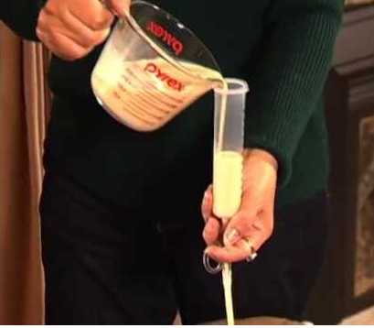
TYPES OF FEEDING :
Bolus Feeding :
The total volume of feeds administered should not exceed 400ml during each bolus feed.
Both the speed and volume with which formula is delivered has an impact on intragastric pressure and the probability of astrooesophageal reflux .
Bolus feeding of more than 400 ml and rapid infusion may result in abdominal distension and discomfort.

Slide 23
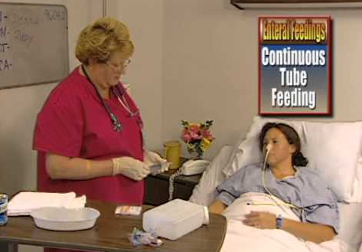
…TYPES OF FEEDING :
Continuous Feeding
Use feeding pump for administration of continuous feeds. Start with an initial slow rate of 10 to 40 ml/hour. Advance to the goal rate by increasing the rate by 10 to 20 ml/hour every 8-12 hours as tolerated.
Continuous feeding is recommended for patients who are critically ill, receiving jejunal feedings; or patients who are unable to tolerate intermittent feedings. Pump-assisted delivery of enteral feeds is highly recommended for small-bowel feeding.

Slide 24
Management of Feeding Intolerance
When patient shows signs of feeding intolerance such as nausea,
vomiting, abdominal distension and pain:
Perform a physical examination of the abdomen including
Assessment for presence of abdominal pain and bowel sounds.
Feeding should only be stopped abruptly for those patients who demonstrate overt regurgitation or aspiration.

Slide 25
Monitoring and Management of Gastro-intestinal Tolerance
Gastric residual volume (GRV) should be checked 4-8 hourly in Continuously fed patients and before each intermittent feeding.
GRV greater than 200 ml should prompt careful bedside evaluation and initiation of appropriate feeding method and feeding volume. GRV reading should be evaluated in conjunction with physical examination for abdominal distension, absence of bowel sounds, and presence of nausea and vomiting.
A trend in GRV may be more important than an isolated high level of GRV.
There is no significant difference between returning and not returning gastric residuals.

Slide 26
DECLOGGING :
Use warm water to declogg obstructed feeding tubes. If unsuccessful, pancreatic enzyme with sodium bicarbonate may be used.
Warm water is the most effective irrigant in declogging blocked feeding tubes. However, a solution of digestive enzymes
(pancrealipase) mixed with sodium bicarbonate (to activate the
enzyme ) has been shown to be fairly effective in dissolving formula occlusions.

Slide 27
CONCLUSION:
Patients in the hospital, as well as home care settings, often require
nutritional supplementation with enteral feeding. Enteral feeding can
be administered via nasogastric, nasoduodenal and nasojejunal
means. The focus of this clinical practice guideline is on the nursing
management of nasogastric tube feeding.
Nasogastric tube feeding may be accompanied by complications.
Thus, it is important for the practitioner to be aware of how to prevent
these complications so that nasogastric tube feeding can be
administered successfully and safely.

Slide 28
SUMMARY:
Today we had demonstrate a Nasogastric tube insertion and feeding procedure through video clips and power point presentation. Here we summarized all the important parameters of the process of NGT including its definition, purposes, detailed procedure etc.

